Slide 1
Bluebook_ Cox_CIAM_HealthScorecard_v1.0

Slide 2
Table of Content
Process Overview
Process Introduction
Business Context
Activity Introduction
Process Flow
Procedural Steps
Input Data Sources
Process Tools
Project Milestones
Revision History
Appendix
eClerx Team Org Chart

Slide 3
Process Overview

Slide 4
Process Introduction
Cox Communications, also known as Cox Cable, is a major American digital cable television provider & telecommunications company. It offers a variety of services including high-speed internet, cable TV, home phone, and smart home solutions.
Founded nearly 60 years ago, Cox Communications is a subsidiary of Cox Enterprises and operates in more than 30 states across the U.S., serving nearly seven million homes and businesses. The company is known for its fiber-powered networks and commitment to creating meaningful connections through technology.
Cox CIAM, Cox Communications Identity and Access Management (CIAM) is a system designed to manage and secure user identities and access to various services and applications. CIAM solutions typically include features such as user registration, authentication, authorization, and profile management. These systems are crucial for ensuring that only authorized users can access sensitive information and services, enhancing both security and user experience.
Cox Self Serve, also known as Cox Easy Connect, is a convenient self-installation option provided by Cox Communications. It allows customers to set up their internet, TV, and phone services without needing a technician.

Slide 5
Business Context
BACKGROUND & OBJECTIVES
BUSINESS OUTCOMES
Client Focus
eClerx will assist Cox by providing support on building an integrated data staging layer & Tableau dashboards with integration to AWS S3 with Snowflake & Adobe as the source of the data to drive
1. An integrated data layer by connecting with Snowflake & Adobe and creating a Analytical data set for better BI & Insights
2. Auto extraction of information, contents & Email creatives from Email files and populating the fields in Email Meta Data & design data model and ETL procedures to create Customer and Campaign level views
3. Designing the data model and ETL procedures to create customer and campaign creatives level dashboard views in Tableau
4. Comprehensive and consolidated report summarizing the performance of campaigns selected by business
Key Success Criteria
Creation of staging data model & layer connected with the actual snowflake & adobe data sources to derive business insights and KPI performance
Creation of ETL pipelines with AWS S3 leveraging the AWS Glue and Cox AWS Team support to enable auto extraction of relevant data for the data model
Design Tableau driven reporting dashboard for the business with integration with the data model layer to enable data driven decision making
Deployment of the solution into production environment post the testing & sign off by the business users
Project Scope: CIAM and Self Serve Data and Reporting
Country: USA
Categories: Data Engineering & BI Dashboards
BI/Reporting Format: Tableau
Deliverables: Data Model & BI Dashboards
Frequency: Weekly/Monthly
Drivers & Downloads
Insights & recommendations
to drive performance
What matters to the Client

Slide 6
Activity Introduction

Slide 7
Process Flow
eClerx data engg. team leverages AWS Athena to query the data and create the staging layer in AWS of the data model
Cox Insights & Business team validates the data, KPIs and Metrics calculations and data
eClerx BI team leverages the staging data model to design the Tableau Dashboards
Share and iterate over the designed dashboards in line with Cox Business Inputs
Cox uploads the required identified data sources into the AWS S3 for the eClerx Team
For all the dashboards the following high-level process is being followed

Slide 8
Procedural Flow
Data engg. team work on the different tools based on the roadmap and planned activities
Extracted data is saved and resides on the AWS S3 for client teams review and validation
BI Team leverages the data in the staging tables for designing the Tableau dashboards in Cox Environment
Tableau dashboards are shared with client for validation and feedback
eClerx team got access from Cox for AWS environment through remote desktop
For all the dashboards the following procedures are being followed

Slide 9
Input Data Sources
How to get accesses
Data Source Access Management
Accesing Input File
Ingested data in AWS S3 – Cox
Account & profile fact tables in AWS – Cox
Designing of data ETL pipelines in AWS – Cox
AWS S3 Connectivity to Tableau – Cox
Tableau access & dashboards – Cox
Tool Name | Team member | Access type (Read, Write, R/W) | When was it procured | Client POC for any help
AWS Data (S3) | Shital Manke Shalini Dwivedi Sharmiladevi S Dhanaji Patil Dipesh Musale | R | 01 Sep’24 | Praveen Prabhakaran
AWS Services (Athena & Glue) | Shital Manke Shalini Dwivedi Sharmiladevi S Dhanaji Patil Dipesh Musale | R/W | 01 Sep’24 | Praveen Prabhakaran
Tableau | Shital Manke Shalini Dwivedi Sharmiladevi S Dhanaji Patil Dipesh Musale | R/W | 01 Sep’24 | Praveen Prabhakaran

Slide 10
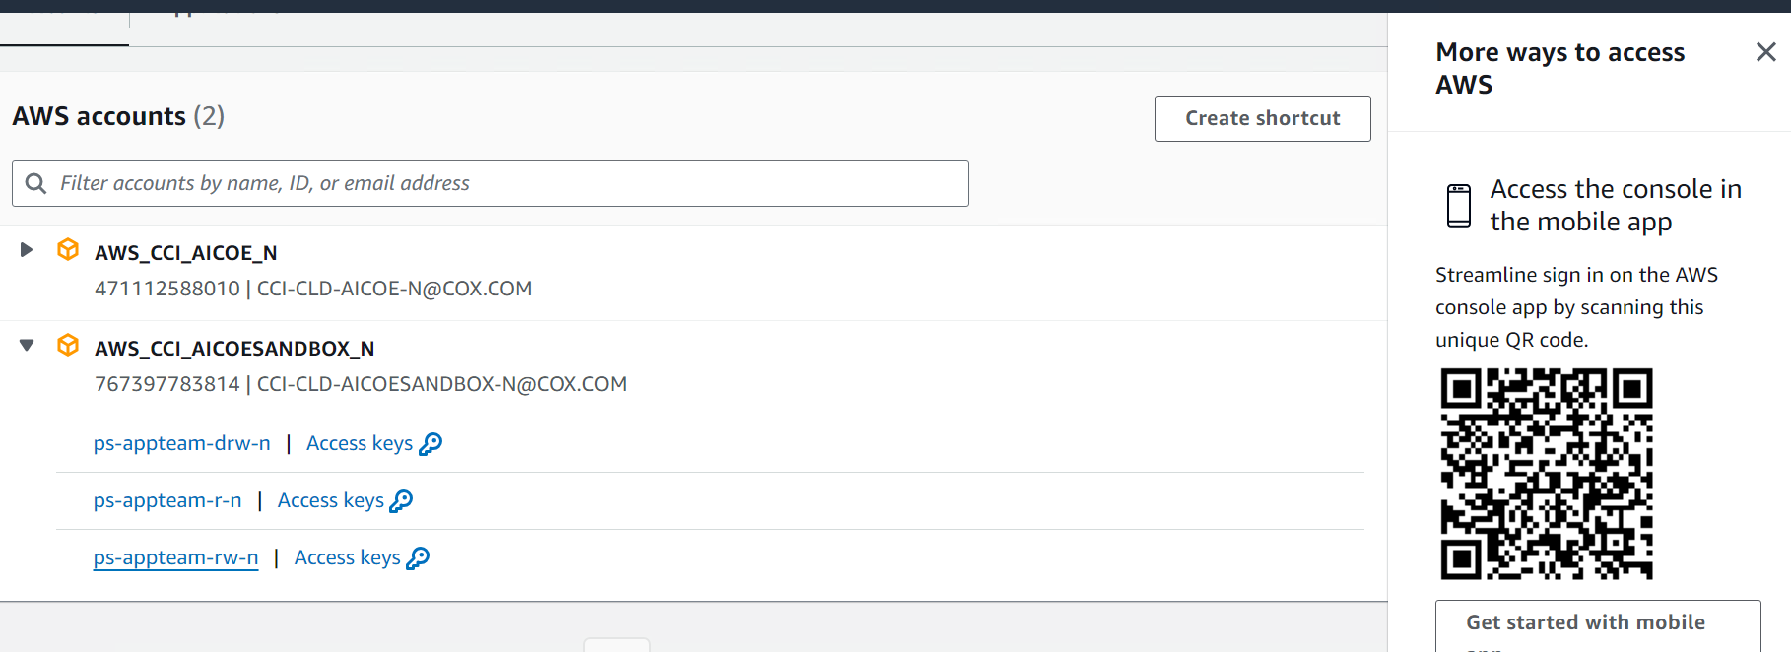
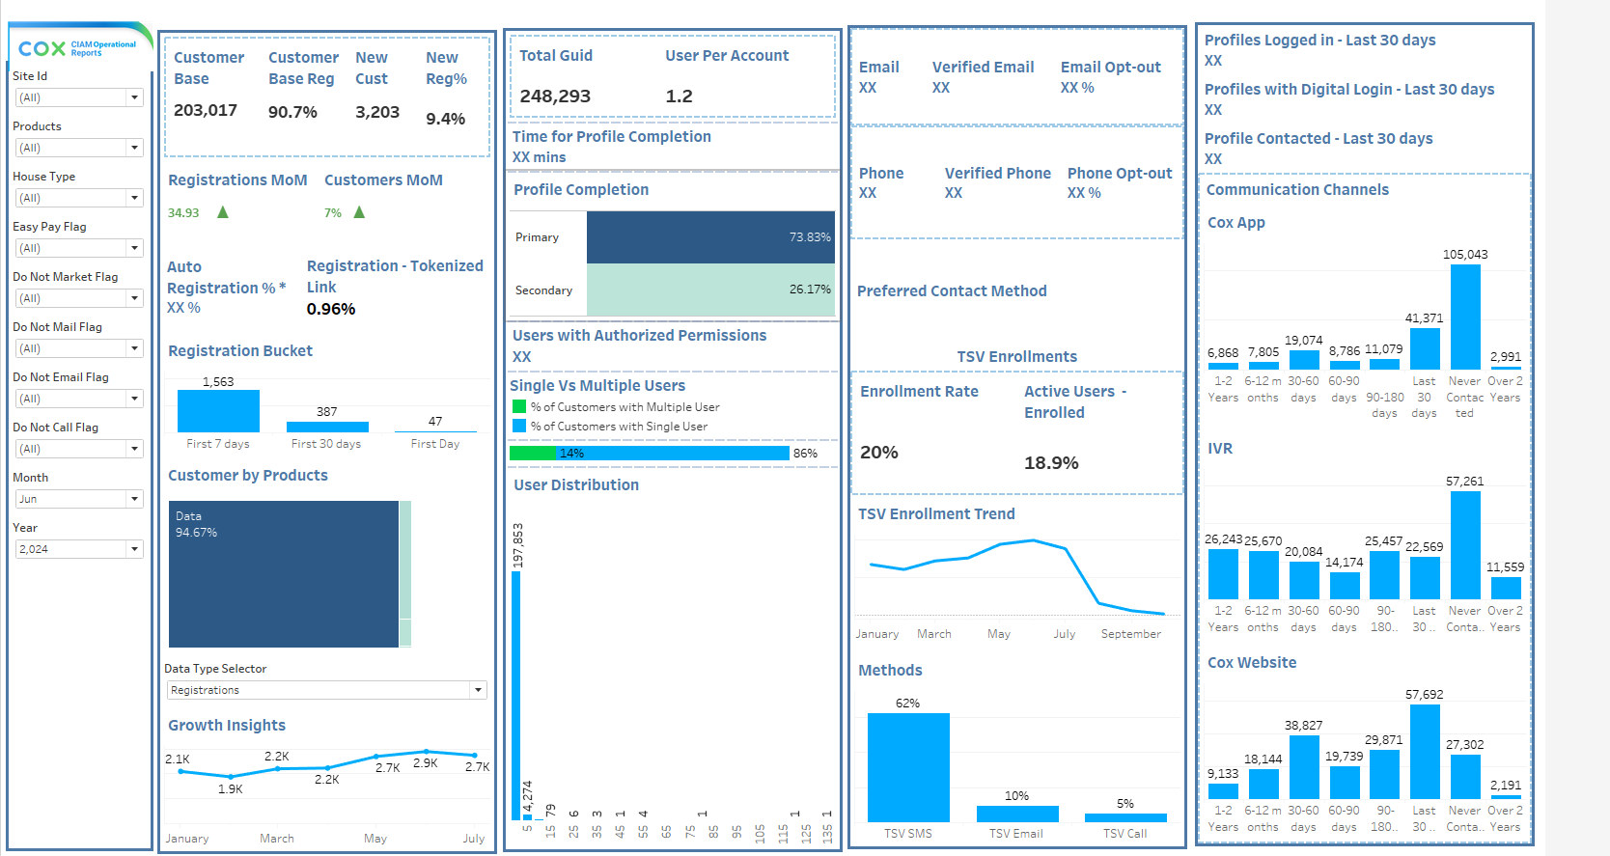
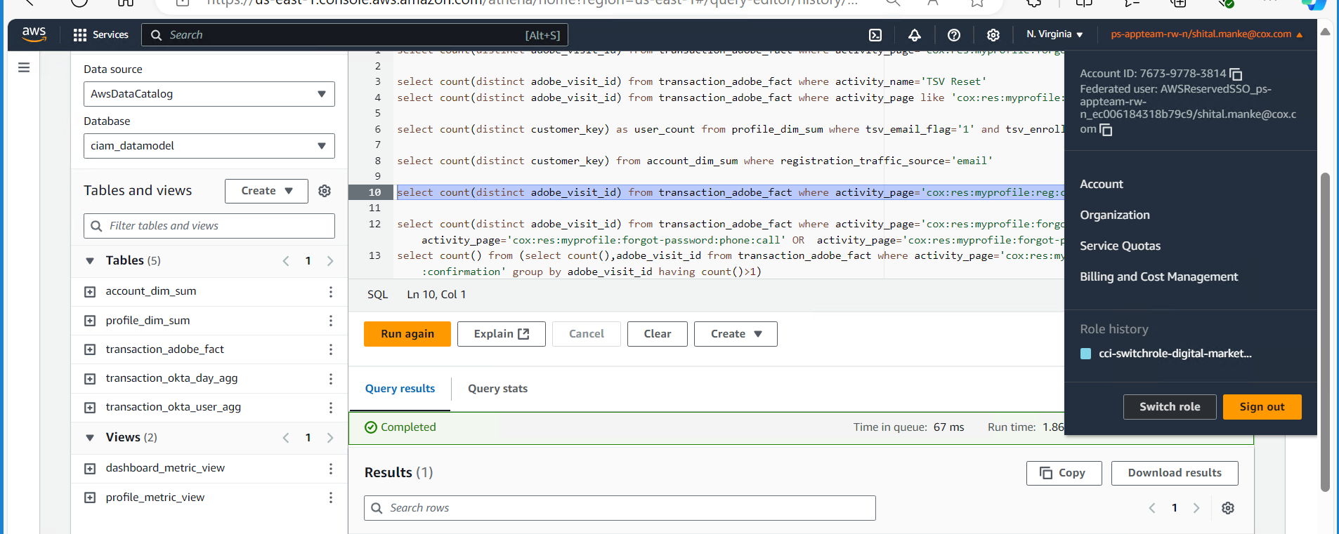
Process Tools
AWS S3
AWS Athena & AWS Glue
Tableau

Slide 11
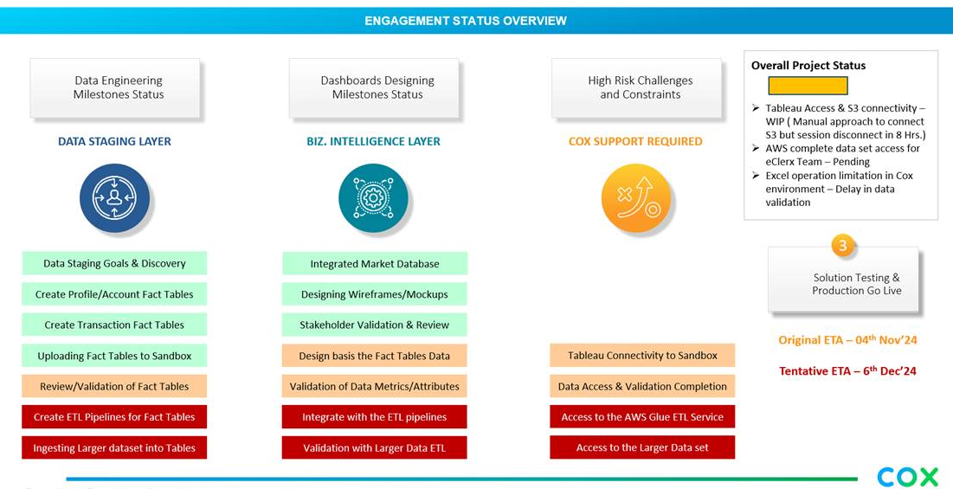
Milestones

Slide 12
Revision History

Slide 13
Revision History
Name | Date | Reasons for Change | Event ID | Version | Verified By | Approved By
Harvinder Pal Singh/Vikas Tiwari | 21-Oct-24 | Creation of Bluebook | NA | 1.0 | Harvinder Pal Singh/Vikas Tiwari | TBD

Slide 14
Appendix

Slide 15
eClerx team Org Chart
Cox Program Sponsor
Cox AI, Analytics & Insights Teams
Matt Earnest/Elliot Schwartz
Richard Brown/Praveen Prabhakaran
eClerx Engagement Lead
eClerx Delivery Management Lead
Bhaskar Dey
Ashish Vashishta
Dedicated Delivery Team
Delivery Leads
Vikas Tiwari | Harvinder Pal Singh
Data Engg. Team
Shital Manke | Shalini Dwivedi | Dipesh Musale
BI Team
Sharmiladevi S | Dhanaji Patil

Slide 16
Thank you

